Slide 1
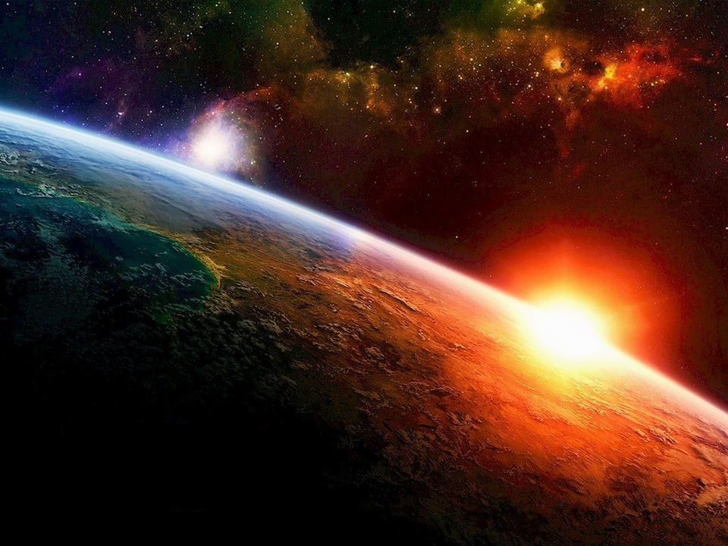


Slide 2
Revelation 17

Slide 3

Revelation 17: Outline
God’s View of Non-repentant Sinner
Kings of the Earth
“Bottomless Pit” (Abyss)
Nicknames
10 Kings
7 Kings + 1
Who Is The “Harlot”

Slide 4
Revelation 17: Outline
God’s View of Non-repentant Sinner
Kings of the Earth
“Bottomless Pit” (Abyss)
Nicknames
10 Kings
7 Kings + 1
Who Is The “Harlot”

Slide 5
Revelation 17:1-5
¹ And there came one of the seven angels which had the seven vials, and talked with me, saying unto me, Come hither; I will shew unto thee the judgment of the great harlot that sits upon many waters:
² With whom the kings of the earth have committed fornication, and the inhabitants of the earth have been made drunk with the wine of her fornication.
³ So he carried me away in the spirit into the wilderness: and I saw a woman sit upon a scarlet-colored beast, full of names of blasphemy, having seven heads and ten horns.
⁴ And the woman was arrayed in purple and scarlet color, and decked with gold and precious stones and pearls, having a golden cup in her hand full of abominations and filthiness of her fornication:
⁵ And upon her forehead was a name written, MYSTERY, BABYLON THE GREAT, THE MOTHER OF HARLOTS AND ABOMINATIONS OF THE EARTH.
Judgment of villain(s) has taken place!
Notes:
Just like that, the judgment of villain of Revelation has occurred.
Armageddon is simply God settling his differences with the villain.
No huge fanfare
No elaborate events occurring

Slide 6
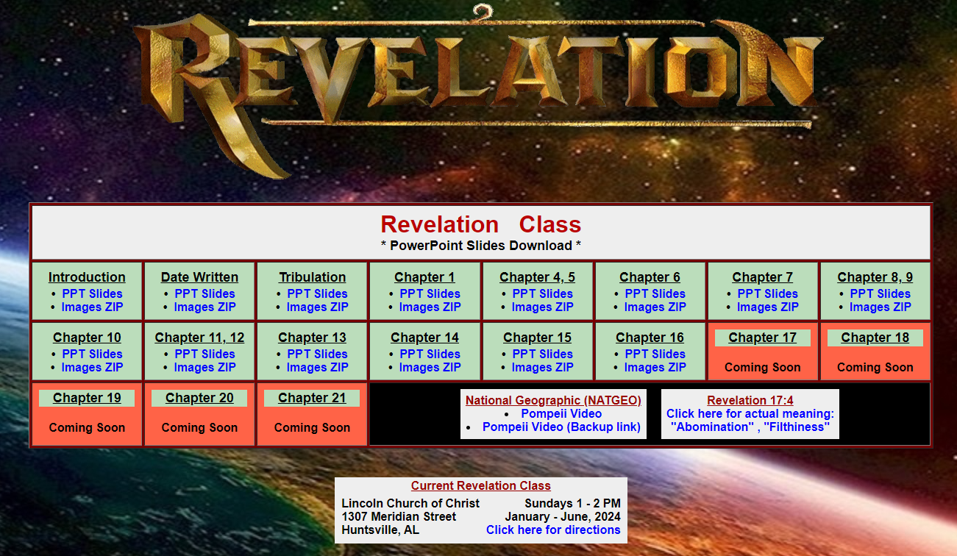

Slide 7
Revelation 17: Outline
God’s View of Non-repentant Sinner
Kings of the Earth
“Bottomless Pit” (Abyss)
Nicknames
10 Kings
7 Kings + 1
Who Is The “Harlot”

Slide 8
Revelation 17:1-2
¹ And there came one of the seven angels which had the seven vials, and talked with me, saying unto me, Come hither; I will shew unto thee the judgment of the great harlot that sits upon many waters:
² With whom the kings of the earth have committed fornication, and the inhabitants of the earth have been made drunk with the wine of her fornication.
Armageddon is complete
God settled his differences with villain
Description of “kings of earth”
No proof kings of the earth killed Saints
Why blame the kings of the earth?
Notes:
Question: How has the association between the “kings of the earth” and the villain caused the inhabitants of the earth to be made drunk with the wine of this association?
Answer: Revelation 18 answers that question
Kings of earth are taking partial blame for what villain has done.
Revelation 18:3-5
[3] For all nations have drunk of the wine of the wrath of her fornication, and the kings of the earth have committed fornication with her, and the merchants of the earth are waxed rich through the abundance of her delicacies.
[4] And I heard another voice from heaven, saying, Come out of her, my people, that ye be not partakers of her sins, and that ye receive not of her plagues.
[5] For her sins have reached unto heaven, and God hath remembered her iniquities.
Rev 18 – come out from among them

Slide 9
2 John 1:10-11
¹⁰ If there come any unto you, and bring not this doctrine, receive him not into your house, neither bid him God speed.
¹¹ For he that bids him God speed is partaker of his evil deeds.
χαίρειν (chairein) - Ref #5463 ¹
7x in N.T.
“God speed” (2 translations only – KJV, Douay-Rhimes Bible)
Welcome into house
Greet with joy, gladness, encouragement, cheer, rejoicing
Held accountable for:
Encouraging, enabling, facilitating evil?
O.T. - Judged action N.T. - Judges attitude (heart)
¹ biblehub.com
Notes:
If we encourage, enable, and/or facilitate evil, we will be held accountable.

Slide 10
Revelation: “Armageddon”
Armageddon = End of World?
Revelation 16
not say Armageddon is end of world
Revelation 17
KOE will be punished for their association with villain
KOE mourn villain’s judgment (impact on wealth/power)
Revelation 18 - Saints told:
Come out from among them (KOE)
Do not partake in their sins (KOE)
So you won’t receive KOE’s plagues
32 items of trade listed that are impacted
Revelation 17, 18 - Not happen if world ended in Revelation 16
Notes:
In eternity, wealth and power are the last things on our minds

Slide 11
Revelation: Kings of the Earth
Revelation 6:15
KOE hid in dens and rocks of mountains from wrath of God
Revelation 16:14
KOE prepare for spiritual battle with God
Revelation 17:2, 18
KOE guilty because allow villain to reign over them
. . . In exchange for power and wealth
Revelation 18:3, 9
KOE received wealth and power
KOE mourn villain’s judgment & impact on wealth
Saints warned about participating with KOE
Rev 18
Saints come out from among
Not partake in her sins
Not receive KOE’s plagues
Notes:
Rev 18
Saints come out from among
Not partake in her sins
Not receive KOE’s plagues

Slide 12
Revelation 17: Outline
God’s View of Non-repentant Sinner
Kings of the Earth
“Bottomless Pit” (Abyss)
Nicknames
10 Kings
7 Kings + 1
Who Is The “Harlot”

Slide 13
> > Revelation 9:1-2, 11 < <
Revelation 9:1-2
¹ And the fifth angel sounded, and I saw a star fall from heaven unto the earth: and to him was given the key of the bottomless pit.
² And he opened the bottomless pit; and there arose a smoke out of the pit, as the smoke of a great furnace; and the sun and the air were darkened by reason of the smoke of the pit.
Revelation 9:11
¹¹ And they had a king over them, which is the angel of the bottomless pit, whose name in the Hebrew tongue is Abaddon, but in the Greek tongue hath his name Apollyon.
Revelation 11:7
⁷ And when they shall have finished their testimony, the beast that ascends out of the bottomless pit shall make war against them, and shall overcome them, and kill them.

Slide 14
“Bottomless Pit”
Thick smoke rises like great furnace
Like torment
2. Satan (high ranking demon) controls pit
“Abaddon” (Hebrew), “Apollyon” (Greek)
The “Destroyer”
3. Beast from bottomless pit wars against saints
Residence are evil
4. Abyss, Torment, Bottomless Pit – same place?
5. Revelation 17 - Beast from bottomless pit go into “perdition”
Notes:
This is speculation based upon some amount of sound evidence
Is “torment” & “Bottomless Pit” & “abyss” the same place?

Slide 15
Revelation 17: “Bottomless Pit”
Revelation 17:8
⁸ The beast that you saw was, and is not; and shall ascend out of the bottomless pit, and go into perdition: and they that dwell on the earth shall wonder, whose names were not written in the book of life from the foundation of the world, when they behold the beast that was, and is not, and yet is.
Bottomless Pit
ἀβύσσου (abyssou) - Ref #12 ¹
6x in N.T.
Boundless, unfathomable depth
Bottomless pit or abyss
Jews - Home of evil spirits
Perdition
ἀπώλειαν (apōleian) - Ref #684 ¹
9x in N.T.
Eternal misery, ruin, perish
Utter destruction
Consistent with Hell ¹
¹ biblehub.com
Notes:
Bottomless pit” – found 7x in Revelation
Clearly, evil resides in the bottomless pit.
Bottomless Pit – A stopping point on way to perdition. Is this “torment”?
“wonder”:
to marvel, wonder
NASB Translation
am amazed (1), amazed (15), amazement (1), astonished (3), being amazed (1), flattering (1), marvel (4), marveled (5), marveling (2), surprised (2), wonder (2), wondered (4), wondering (2).

Slide 16
Revelation 17: Outline
God’s View of Non-repentant Sinner
Kings of the Earth
“Bottomless Pit” (Abyss)
Nicknames
10 Kings
7 Kings + 1
Who Is The “Harlot”

Slide 17














Revelation 17: Nicknames
“T – Town”
“12th Man”
“The Plains”
“Between
the Hedges”
“Rocky Top”
“Blue Grass State”
“Music City”
“Death Valley”
“Hog Pen”
“The Zou”
“Death Valley”
“Horseshoe”
“The Swamp”
“Big House”
Notes:
Ole Miss and Mississippi State
Michigan – 3rd largest sports stadium in the world with 107,000 seating capacity
Apostle John – “The one whom Jesus loved”
Apostle Thomas – “The Doubter” or “Doubting Thomas”
Some may be called by a nickname instead of formal name written on your birth certificate.

Slide 18
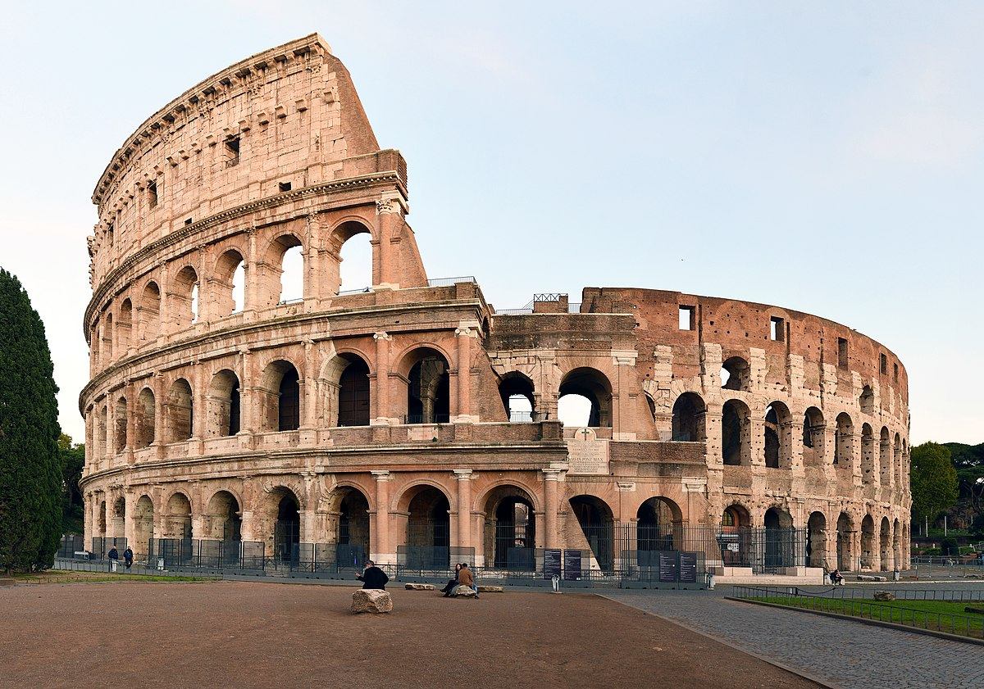
Nickname for Rome:
“The City Which Sits On 7 Mountains”
Notes:
What was the Greeks’ nickname for Rome?

Slide 19
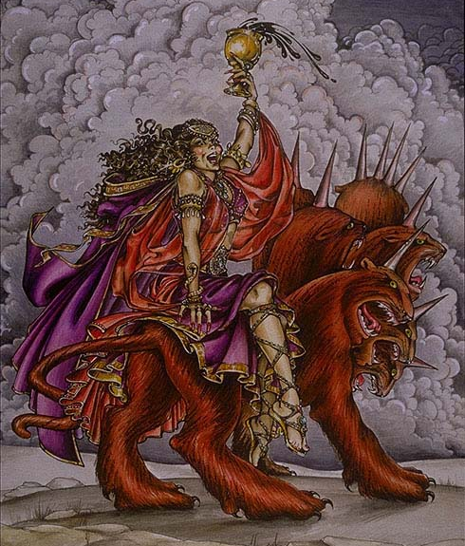
Revelation 17:3, 9
³ So he carried me away in the spirit into the wilderness: and I saw a woman sit upon a scarlet-colored beast, full of names of blasphemy, having seven heads and ten horns.
⁹ And here is the mind which has wisdom. The seven heads are seven mountains, on which the woman sits.
Mountains
ὄρη (orē) – Ref #3735 ¹
7x in N.T. ¹
A rising(s); hill(s); mountain(s)
“hills” - 14 translations ¹
“mountains” - 32 translations ¹
Sits
κάθηται (kathētai)
Ref #2521 ¹
2x in N.T. (Rev) ¹
Dwell ¹
Reside ¹
¹ biblehub.com
Notes:
“He that has an ear, let him hear what the Sprit says to the churches” – 7x
“He that has an ear, let him hear” – 1x – he that leads into captivity . . . Revelation 13:9-10
“Here is wisdom. Let him who has understanding calculate the number of the beast . . .” – intro to “666” – Revelation 13
“Here is the mind that has wisdom” – 7 mountains

Slide 20
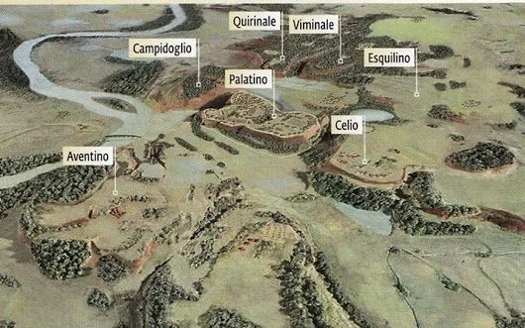
“City That Sits On 7 Mountains / Hills”
Palatine
Capitoline
Aventine
Caelian
Esquiline
Viminal
Quirinal
Notes:
“He that has an ear, let him hear . . .”
“Here is wisdom” – introduction of 666
“Here is the mind that has wisdom” – 7 mountains

Slide 21
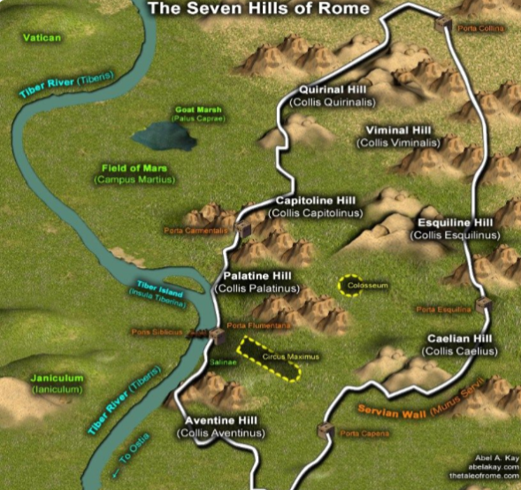

“City That Sits On 7 Mountains / Hills”
Palatine
Capitoline
Aventine
Caelian
Esquiline
Viminal
Quirinal
https://www.pinterest.com/pin/hills-of-rome-map--591238257340859242/
Notes:
Not hills “near by” like Jerusalem, Rome was actually built on these hills.

Slide 22
Revelation 17: Outline
God’s View of Non-repentant Sinner
Kings of the Earth
“Bottomless Pit” (Abyss)
Nicknames
10 Kings
7 Kings + 1
Who Is The “Harlot”

Slide 23
Revelation 17:12-17
¹² And the ten horns which you saw are ten kings, which have received no kingdom as yet; but receive power as kings one hour with the beast.
¹³ These have one mind, and shall give their power and strength unto the beast.
¹⁴ These shall make war with the Lamb, and the Lamb shall overcome them: for he is Lord of lords, and King of kings: and they that are with him are called, and chosen, and faithful.
¹⁵ And he saith unto me, The waters which you saw, where the harlot sits, are peoples, and multitudes, and nations, and tongues.
¹⁶ And the ten horns (ten kings) which you saw upon the beast, these shall hate the harlot, and shall make her desolate and naked, and shall eat her flesh, and burn her with fire.
¹⁷ For God has put in their hearts to fulfil his will, and to agree, and give their kingdom unto the beast, until the words of God shall be fulfilled.

Slide 24
Revelation 17: “10 Kings”
“10 Kings”
Do not have kingdom of their own
“Kings” currently give allegiance to “harlot”
Lamb will defeat them; they will do the will of Lamb
God puts it in their heart to hate the “harlot”
Evil punishes evil; unrighteous used fulfill God’s will
Will hate, fight, and defeat the “harlot”
God enforce judgment using “inside” players
Pre-M want 10 literal people, so . . . . . .
Notes:
Evil used to fulfill God’s will:
Babylonians and Assyrians taking Hebrews into captivity
Jews/Romans crucify Jesus
Roman soldier piercing Jesus’ side
Beast’s 10 horns represents 10 kings
10 Kings not in power at time of Revelation
10 Kings give allegiance to “Harlot”
Lamb will defeat them; do will of the Lamb
Will hate the “Harlot”, war against “Harlot”, defeat “Harlot”
Once again, evil punishes evil
“God puts in the their hearts to fulfill his will”
God uses unrighteous to accomplish his will
God will enforce judgment “from the inside, inner circle”
“10 Kings” – “10” could just mean “complete”
“10” – literal or figurative?
Risky to assign names to symbols in Rev. like Pre-M do
In some cases, you may, if you remain consist with Rev. and History
History says there are literally 10 kings that take out Rome

Slide 25
“10 Kings”
10 Barbaric kingdoms under Rome ¹
Vandals
Alans
Suevians
Visigoths
Burgundians
Franks
Saxons
Huns
Lombards
Ostrogoths
(N. Africa)
(Spain)
(Portugal)
(SW France) (Alaric)
(Germany)
(Western France)
(Britain)
(Kazakhstan)
(Southern Italy)
(North Black Sea)
1 http://www.ushistory.org/civ/6f.asp
https://www.newtonproject.ox.ac.uk/view/texts/normalized/THEM00200
https://www.blueletterbible.org/Comm/newton_isaac/prophecies/daniel06.cfm
Notes:
Alaric the Goth King
Lost Ark – 410 AD destroyed Rome; took gold and silver
Died and buried in S. Italy
Hitler searched for Alaric’s treasure hoping to find lost ark
Clive Owens “King Arthur”
Saxon incursion from N. Britain; Rome pulled out of Rome

Slide 26
Revelation 17: Outline
God’s View of Non-repentant Sinner
Kings of the Earth
“Bottomless Pit” (Abyss)
Nicknames
10 Kings
7 Kings + 1
Who Is The “Harlot”

Slide 27
Revelation 17:10-11 - “7 Kings + 1”
3 Agreements
Rev 7:14 – Souls beneath altar are Christians
Revelation written after church established
Rev 20:14 – Beheaded for witness of Jesus
Rev 12:11 – Overcame Satan with blood of Lamb
Rev 16:6 – Villain shed blood of Christians
Purpose of God’s judgment in Revelation
Rev 17:11 – All 8 kings being judged, go into perdition
Notes:
“Jesus”, “blood of Lamb” – Christian, not Jews
Is everyone in agreement with these observations?
This question is not to bait anyone, or set anyone up.
Facts are necessary in order for 7 Kings + 1 to make sense
Rev 7:14 – Souls beneath altar are Christians
Revelation written after church established
Rev 20:14 – Beheaded for witness of Jesus
Rev 12:11 – Overcame Satan with blood of Lamb
Rev 16:6 – Villain shed blood of Christians
Rev 17:11 – All 8 kings in judgment, go into perdition
Villain is not a single person – it is a group of individuals
Who are these 7 kings + 1?
Opinions vary depending upon agenda

Slide 28
Revelation 17:10-11 - “7 Kings + 1”
¹⁰ And there are seven kings: five are fallen, and one is, and the other is not yet come; and when he comes, he must continue a short space. ¹¹ And the beast that was, and is not, even he is the eighth, and is of the seven, and goes into perdition.
?
?
49 - 44 BC: Julius Caesar
27 BC - 14 AD: Augustus
14 - 37 AD: Tiberius
37 - 41 AD: Caligula
41 - 54 AD: Claudius
68 AD’ers
5 are fallen
54 - 68 AD: Nero
1 is
68 - 69 AD: Galba
1 not yet come
?
69 AD: Otho
8th
Notes:
One of few topics in Revelation that the 68 AD’ers, 95 AD’ers, and independents agree upon in principle
But, not in application
Question: 7 kings + 1 claim of 69 AD’ers contains an error.
What is the error?
Answer:
Julius Caesar & Augustus did not know what a Christian is! How can they be guilty of shedding the blood of Christians?
Domitian is missing - Jerome (347-420 AD) said Nero and Domitian both persecuted Christians
Online Revelation forums:
68 AD’ers claim Domitian not part of persecution

Slide 29
Revelation 17:10-11 - “7 Kings + 1”
¹⁰ And there are seven kings: five are fallen, and one is, and the other is not yet come; and when he comes, he must continue a short space. ¹¹ And the beast that was, and is not, even he is the eighth, and is of the seven, and goes into perdition.
?
68 - 69 AD: Galba
69 AD: Otho
69 AD: Vitellius
69 - 79 AD: Vespasian
79 - 81 AD: Titus
95 AD’ers
5 are fallen
81 - 96 AD: Domitian
1 is
96 - 98 AD: Nerva
1 not yet come
?
98 - 117 AD: Trajan
8th
Notes:
One of few topics in Revelation that the 68 AD’ers, 95 AD’ers, and independents agree upon in principle
But, not in application
Question: 7 kings + 1 claim of 69 AD’ers contains an error.
What is the error?
Answer:
Nero is missing
Trajan does not belong
Online Revelation forums:
95 AD’ers claim Nero not as bad as Domitian was

Slide 30
Revelation 17:10-11 - “7 Kings + 1”
Align With History
Roman historical custom
Caesar frees political enemies of previous Caesar
Irenaeus (~120 - ~200)
“Against Heresies”, Book V, Chapter 30, vs 3
Apostle John seen at end of Domitian’s reign
Jerome (347-420 AD)
Lives of Illustrious Men “9. John the Apostle”
Nero and Domitian both part of persecution
Nero’s 1st wave, Domitian 2nd wave
Domitian banished John to Patmos
Notes:
Asian clergy who were eye-witness to John the Apostle after Patmos were also contemporaries of Irenaeus.

Slide 31
Revelation 17:10-11 - “7 Kings + 1”
Align With History
Eusebius (260 – 339 AD)
Book 3:17-18
Nero and Domitian both persecuted Christians
John was condemned to Patmos
Book 3:23
John left Patmos on death of Domitian, more ministry
Lived at least until the time of Trajan (98-117 AD)
Eusebius quotes Irenaeus:
“All clergy in Asia came in contact with John.”
Completely consistent with Revelation 10
These clergy were contemporaries of Irenaeus
https://emp.byui.edu/SatterfieldB/Rel212/Eusebius/Eusebius%20on%20John.htm
Notes:
Irenaeus (~120 - ~200)
Who are you going to trust?
Monday morning arm-chair quarterback?
Irenaeus, who had direct access to eye-witnesses of the Apostle John?

Slide 32
Revelation 17:10-11 - “7 Kings + 1”
¹⁰ And there are seven kings: five are fallen, and one is, and the other is not yet come; and when he comes, he must continue a short space. ¹¹ And the beast that was, and is not, even he is the eighth, and is of the seven, and goes into perdition.
54 - 68 AD: Nero
68 - 69 AD: Galba
69 AD: Otho
69 AD: Vitellius
69 - 79 AD: Vespasian
History
5 are fallen
79 - 81 AD: Titus
1 is
81 - 96 AD: Domitian
1 not yet come
96 - 98 AD: Nerva
8th
Notes:
This alignment does not contradict:
History
Revelation
Early Historians
Early Church Leaders
Can these 7 kings + 1 be alignment with history, and be logically proven?
Yes
Ch. 17 is about positively identifying the villain of Revelation

Slide 33
Revelation 17:10-11 - “7 Kings + 1”
49 - 44 BC:
27 BC - 14 AD:
14 - 37 AD:
37 - 41 AD:
41 - 54 AD:
54 - 68 AD:
68 - 69 AD:
69 AD:
69 AD:
69-79 AD:
79-81 AD:
81-96 AD:
96-98 AD:
98-117 AD:
117-138 AD:
Julius Caesar
Augustus
Tiberius
Caligula
Claudius
Nero
Galba
Otho
Vitellius
Vespasian
Titus
Domitian
Nerva
Trajan
Hadrian
68 AD’ers
95 AD’ers
History
?
Notes:
Jerome (347-420 AD)
Start with Nero because Nero’s started 1st wave of persecution of Saints
Domitian started 2nd wave of persecution of Saints
Does Nerva’s reign accurately reflect the end of the “7 kings + 1”?
What is so special about Trajan and Hadrian, who followed Nerva as Caesars?
Why are they not part of the 7 Kings + 1 that are going into perdition?

Slide 34
Revelation 17:10-11 - “7 Kings + 1”
Trajan: 98 – 117 AD
Religious Tolerance and Persecution in the Roman Empire
https://www.crf-usa.org/bill-of-rights-in-action/bria-13-4-b-religious-tolerance-and-persecution-in-the-roman-empire
For many years, Christians lived with the uncertainty that another persecution could erupt at any time. In 110, Emperor Trajan attempted to reach a compromise between the growing Christian minority and Roman pagans who demanded that the illegal religious sect be destroyed. Although Trajan authorized arresting Christians, he prohibited general searches to seek them out and ordered Roman officials not to actively interfere with Christian gatherings.
Trajan didn’t like Christians
But, changed Roman Laws on taxing Christians
Started changing attitudes about Christians
Notes:
Trajan’s name is not on that list of 7 Kings + 1 when aligned with history.
Trajan was NOT perfect, but he did what he could do.

Slide 35
Revelation 17:10-11 - “7 Kings + 1”
Hadrian - 117-138 AD
Reign was more tolerant of religions ¹
Persecution reduced
Changed laws:
Continued weakening enforcement of laws against Christians
Being a Christian alone was not enough to take action against them. They had to commit a crime. (e.g. break Roman law)
¹ https://muse.jhu.edu/article/476858/pdf

Slide 36
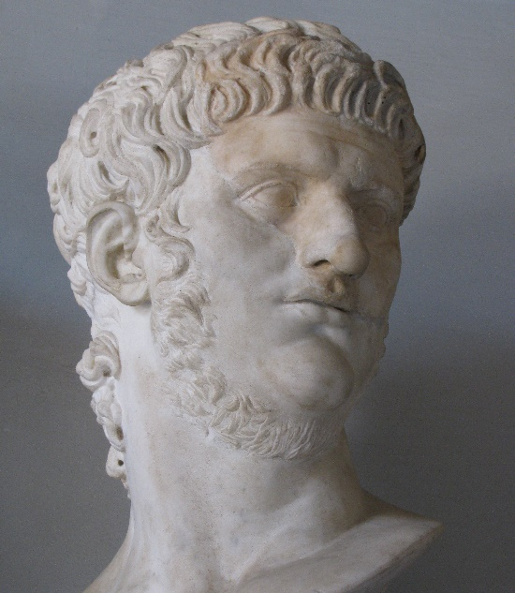
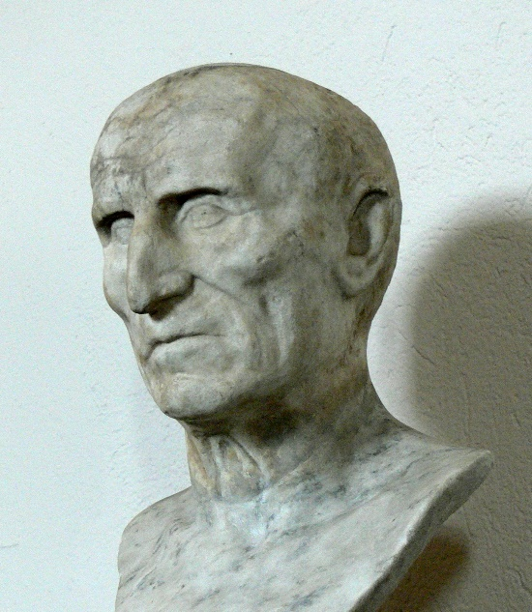
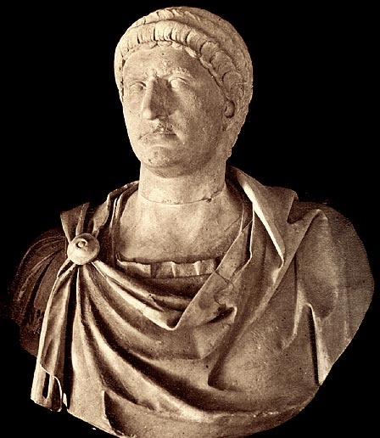
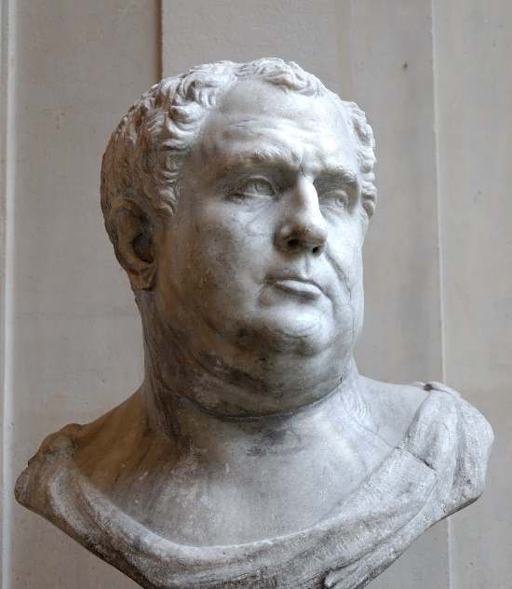
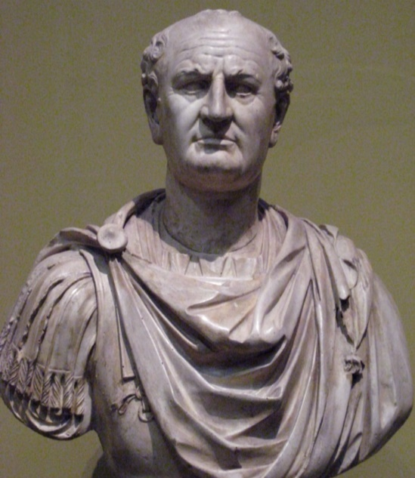
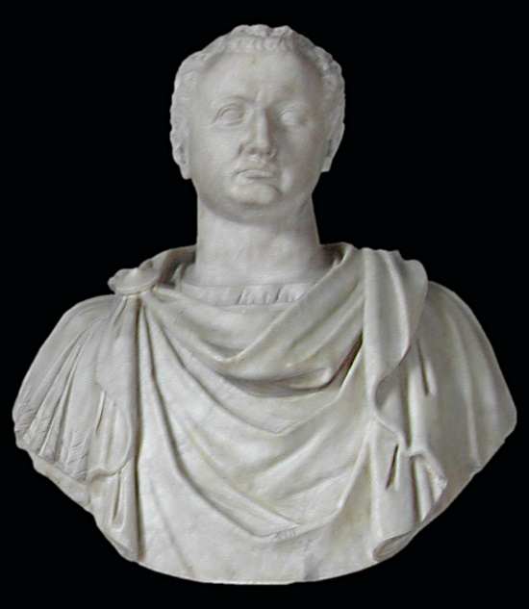
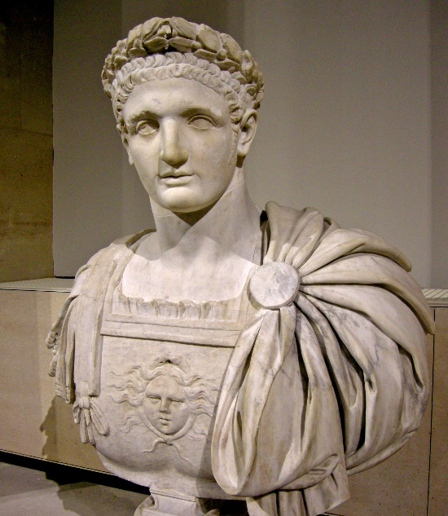
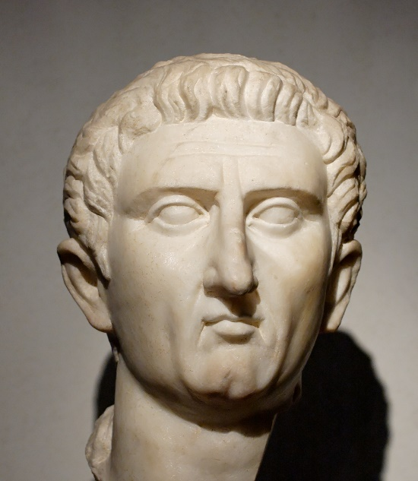
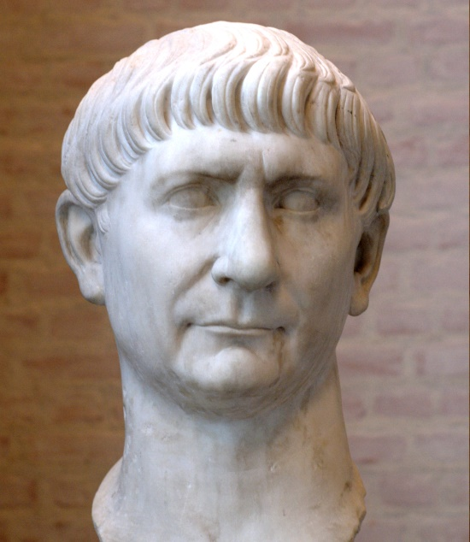
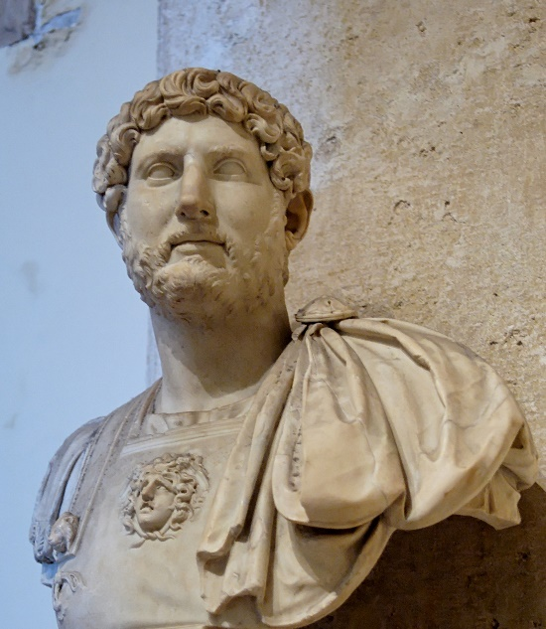
“7 Kings + 1” - Busts
Nero
Galba
Otho
Vitellius
Vespasian
Titus
Domitian
Nerva
Trajan
Hadrian
Notes:
7 kings + 1
Trajan and Hadrian also shown.
They do not belong in the list of 7 kings + 1, but they are being drawn into the discussion by 95 AD’ers

Slide 37
Revelation 17: Outline
God’s View of Non-repentant Sinner
Kings of the Earth
“Bottomless Pit” (Abyss)
Nicknames
10 Kings
7 Kings + 1
Who Is The “Harlot”

Slide 38
Villain Characteristics (1 / 2)
Severe persecution 1st century saints
Imprisonment, starvation, disease, murder, beheading, limited or no buying and selling (13:17) (16:6)
Multiplicity of villains (not single villain) (17, 18)
Guilty: Idolatry, murders, sorceries, fornications, thefts (9:20-21)
Multiplicity of nations, peoples, languages (11:18) (17:15)
World mesmerized by villain
“Who is like the villain?” (13:4)
“Who can make war against villain?” (13:4)
Enforced worship of villain and image (13:15)
Refusal to worship brought death
Number = “666” (13:18)
Blasphemed existence of God (16:9)
Teamed with many kings of the earth (16:12)

Slide 39
Villain Characteristics (2 / 2)
Villain city built on “7 mountains/hills” (17:9)
8 of its first century kings judged for persecution (17:10-11)
Eventually destroyed by 10 kings (17:16)
“Sits on many waters” (worldwide power) (17:15)
Over many people, nations, tongues
Many nations submissive (17:13)
Gave extraordinary power and wealth to villain
Reigned over kings of the earth (17:18)
Vast trade network (18:12)
Great wealth/power to trade partners (18:9)
“Woman” is that “Great City” (17:18)
“Great city” (Ch. 18)

Slide 40
Villain Characteristics
Severe persecution 1st century saints
Imprisonment, starvation, disease, murder, beheading, limited buying and selling
Multiplicity of villains (not single villain)
Guilty: Idolatry, murders, sorceries, fornications, thefts
Multiplicity of nations, peoples, languages
World mesmerized by villain
“Who is like the villain?”
“Who can make war against villain?”
Enforced worship of villain and image
Refusal to worship brought death
Number = “666”
Blasphemed existence of God
Teamed with many kings of the earth
Villain city built on “7 mountains/hills”
8 of its first century kings judged for persecution
Eventually destroyed by 10 kings
“Sits on many waters” (worldwide power)
Over many people, nations, tongues
Many nations submissive
Gave extraordinary power and wealth to villain
Reigned over kings of the earth
Vast trade network
Great wealth/power to trade partners
“Woman” is that “Great City”
“Great city”
Who Is The Harlot?
Notes:
Does not describe
Egypt?
Israel?
Babylon?
Assyrians?
Persians?
Only 1 power that existed in the last half of the 1st century who satisfies all of these characteristics – Rome

Slide 41
Revelation Villain - Does it “add up”?
Villain = Rome
Tribulation = Persecution 1st Century Saints
Rev 18 - Aligns perfect with history
Vast trade network (trade route charts prove)
Matches merchandise list
Rev 17 - Aligns perfect with history
7 Kings + 1
10 Kings
Villain characteristics
“Great City” built on 7 mountains (nickname)
Vast trade network
“Sits on many waters and nations”

Slide 42
Revelation Villain - Does it “add up”?
Villain = Rome
Tribulation = Persecution 1st Century Saints
Rev 13 - Aligns perfect with history
Boycott on saint’s buying and selling
Rev 10 - Aligns perfect with history
John told to continue ministry after Patmos
Eusebius confirms John did
Rev 6 - Aligns perfect with history
4 Horsemen symbolism = saints’ situation
Revelation – Characteristics of villain align with history
Notes:
Over and over we find Revelation perfectly paralleling history without contradiction.
Easily defended.

Slide 43
Revelation 17:6 - Miscellaneous
Revelation 17:6
⁶ And I saw the woman drunken with the blood of the saints, and with the blood of the martyrs of Jesus: and when I saw her, I wondered with great admiration.
Martyr
μαρτύρων (martyrōn) – Ref #3144
9x in NT
Ear or eye witness
Someone who gives evidence or testimony
Does not necessitate a death
Notes:
KJV likes to use “martyr” if referring to someone who dies for their beliefs.
That definition of the word “martyr” came along, apparently, after the Bible was written.
Original meaning of this word did not necessitate the death of the one who prophesies.
The word martyr itself derives from the Greek for “witness”, originally applied to the apostles who had witnessed Christ's life and resurrection. Later it was used to describe those who, arrested and on trial, admitted to being Christians.
https://en.wikipedia.org/wiki/Martyr
In its original meaning, the word martyr, meaning witness, was used in the secular sphere as well as in the New Testament of the Bible.^{[3]} The process of bearing witness was not intended to lead to the death of the witness, although it is known from ancient writers (e.g. Josephus) and from the New Testament that witnesses often died for their testimonies.

Slide 44
Revelation 17:6 - Miscellaneous
Revelation 17:6
⁶ And I saw the woman drunken with the blood of the saints, and with the blood of the martyrs of Jesus: and when I saw her, I wondered with great admiration.
Admiration
θαῦμα (thauma) - Ref #2295
2x in N.T.
To gaze at with wonder, astonishment or amazement as if to look at something strange
Notes:
Admiration in NKJV still does not accurately portray meaning of Greek word

Slide 45
Revelation 17: Outline
God’s View of Non-repentant Sinner
Kings of the Earth
“Bottomless Pit” (Abyss)
Nicknames
10 Kings
7 Kings + 1
Who Is The “Harlot”

Slide 47
> > Revelation 18:3-5 < <
³ For all nations have drunk of the wine of the wrath of her fornication, and the kings of the earth have committed fornication with her, and the merchants of the earth are waxed rich through the abundance of her delicacies.
⁴ And I heard another voice from heaven, saying, Come out of her, my people, that ye be not partakers of her sins, and that ye receive not of her plagues.
⁵ For her sins have reached unto heaven, and God hath remembered her iniquities.
Notes:
Question: How has the association between the “kings of the earth” and the villain caused the inhabitants of the earth to be made drunk with the wine of this association?
Answer: Revelation 18 answers that question
Kings of earth are taking partial blame for what villain has done.
Kings of the earth enabled and encouraged the villain by giving their allegiance and power to the villain.
Rev 18 – come out from among them

